Slide 1



IT INDUSTRY IN PAKISTAN
Probability and Statistics

Slide 2
SIGMA PROGRAMMERS
BSDSF21M055 MUHAMMAD NAEEM
BSDSF21M034 ABDULLAH ASHFAQ
BSDSF21M028 ANAS WALEED TAHIR
BSDSF21M004 MUHAMMAD ZUBAIR
BSDSF21M040 M. ABDULLAH GHAZI

Slide 3
MOTIVATION
What is the satisfaction level of IT employees?
Which programming languages IT professionals suggest to a beginner?
What is relation between education type and salary?
How much practice is required to be good in programming?
What are the most popular programming languages in the Industry?

Slide 4

GENDER RATIO IN IT INDUSTRY

Slide 5
SUGGESTED PROGRAMMING LANGUAGES FOR BEGINNERS

Slide 6
CURRENT JOB STATUS

Slide 7
WORK TYPE

Slide 8
IT CAREERS

Slide 9
SALARY COMPARISON

Slide 10
POPULAR LANGUAGES IN INDUSTRY

Slide 11

WHAT IS THE SATISFACTORY LEVEL OF IT PROFESSIONS?

Slide 12
AI ENGINEERS

Slide 13
SOFTWARE DEVELOPERS

Slide 14
SQA ENGINEER

Slide 15
DATA SCIENTISTS

Slide 16
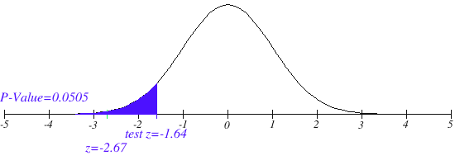
SALARY HYPOTHESIS TESTING
Hₒ: µ = 70
H₁: µ < 70
Z_{cal} = -2.67
Z_{tab} = -1.64
Z_{cal} < Z_{tab} (TRUE)
Hₒ IS REJECTED
We reject the null hypothesis that average salary in Pakistan for IT Professionals is 70 Thousand

Slide 17

CONCLUSION
Since Alternative Hypothesis is True , it concludes that Average income of IT Professionals is less Than 70 Thousand in Pakistan
58.70k < µ < 68.20k

Slide 18
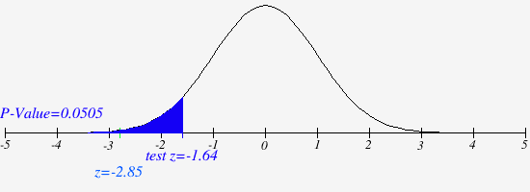
WORKING HOUR HYPOTHESIS TESTING
Hₒ: µ ≥ 8
H₁: µ < 8
Z_{cal} = -2.80
Z_{tab} = -1.64
Z_{cal} < Z_{tab} (TRUE)
Hₒ IS REJECTED
We reject the null hypothesis that on average IT Professionals spend more than 8 hours on the job in Pakistan

Slide 19
CONCLUSION
Since Alternative Hypothesis is True , it concludes that Average working hour of IT Professionals is less than 8 hours in Pakistan
5.72 < µ < 7.60

Slide 20
ANY QUESTION?

Slide 21
THANK YOU!
SIR FAISAL BUKHARI for guiding us throughout the semester

